Slide 1
Playing Atari with Deep Reinforcement Learning
Volodymyr Mnih, Koray Kavukcuoglu, David Silver, Alex Graves, Ioannis Antonoglou,
Daan Wierstra, Martin Riedmiller
Google DeepMind
NIPS 2013
Presented by Yoonsung Kim

Slide 2
introduction
First deep learning model to successfully learn control policies directly from high-dimensional sensory input
Model is a CNN network whose input is raw pixels and whose output is a value function estimating future rewards
Learning Algorithm : Q-learning[1], SGD
Challenges is RL:
Reward is sparse, noisy and delayed
Highly correlated states
Data distribution changes
[1] Christopher JCH Watkins and Peter Dayan. Q-learning. Machine learning, 8(3-4):279–292, 1992.

Slide 3



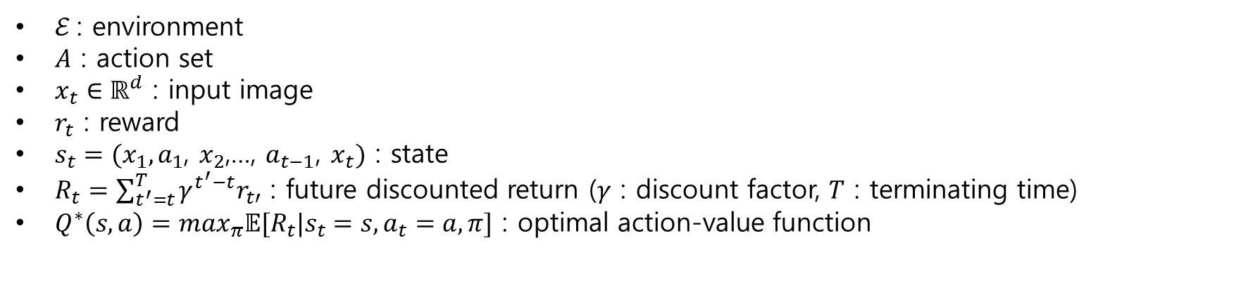



Definitions
input
$$x_{t}$$
$$r_{t}$$
$$r_{t+1}$$
$$a_{t}$$
$$x_{t+1}$$
$ℰ$ : environment
$A$ : action set
$x_{t}∈ℝ^{d}$ : input image
$r_{t}$ : reward
$s_{t}=(x_{1},a_{1}$, $x_{2}$,…, $a_{t−1}$, $x_{t})$ : state
$R_{t}=\sum_{t^{′}=t}^{T}{γ^{t^{′}−t}r_{t′}}$ : future discounted return ($γ$ : discount factor, $T$ : terminating time)
$Q^{∗}\left(s,a\right)=\max_{π}𝔼[R_{t}|s_{t}=s, a_{t}=a, π]$ : optimal action-value function

Slide 4
Bellman equation
input
$$x_{t}$$
$$r_{t}$$
$$r_{t+1}$$
$$a_{t}$$
$$x_{t+1}$$
$Q^{∗}\left(s,a\right)=𝔼_{s^{′}\sim ℰ}\left[r+γ\max_{a^{′}}Q^{∗}\left(s^{′},a^{′}\right) | s, a\right]$
Conversely, if $Q\left(s,a\right)=𝔼_{s^{′}\sim ℰ}\left[r+γ\max_{a^{′}}Q\left(s^{′},a^{′}\right) | s, a\right]$, then $Q=Q^{∗}$.
Problem reduces to find $Q$ which satisfies Bellman equation

Slide 5
Q-learning
Bellman equation : $Q^{∗}\left(s,a\right)=𝔼_{s^{′}\sim ℰ}\left[r+γ\max_{a^{′}}Q^{∗}\left(s^{′},a^{′}\right) | s, a\right]$
Q-learning : iterative update using Bellman equation
->${ Q}_{i+1}\left(s,a\right)=𝔼_{s^{′}\sim ℰ}\left[r+γ\max_{a^{′}}Q_{i}\left(s^{′},a^{′}\right) | s, a\right]$
-> Totally impractical : Q is estimated separately for every pair $(s, a)$

Slide 6

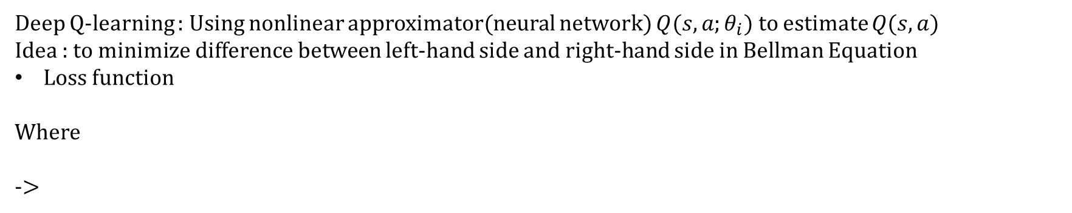
Deep Q-learning
Bellman equation : $Q^{∗}\left(s,a\right)=𝔼_{s^{′}\sim ℰ}\left[r+γ\max_{a^{′}}Q^{∗}\left(s^{′},a^{′}\right) | s, a\right]$
Deep Q-learning : Using nonlinear approximator(neural network) $Q(s,a;θ_{i})$ to estimate $Q(s,a)$
Idea : to minimize difference between left-hand side and right-hand side in Bellman Equation
Loss function
Where
->
Model-free : doesn’t estimate $ℰ$
Off-policy : use $ε$-greedy strategy

Slide 7
Experience replay
Store agent’s experiences $e_{t}=(s_{t},a_{t}$, $r_{t}$, $s_{t+1}$) in a dataset $𝒟$ while playing
Sample fixed number of experiences $e_{1…b}\sim 𝒟$ for data, while trainingc
Advantages :
Each step of experience is potentially used in many weight updates
Fixed problem of strong correlations between consecutive samples
Prevented training samples being dominated by one-sided samples

Slide 8




experiments
Network architecture
$$Q(s,1;θ)$$
210x
160
image
84x
84
image
210x
160
image
84x
84
image
210x
160
image
84x
84
image
$$Q(s,2;θ)$$
210x
160
image
84x
84
image
$$Q(s,3;θ)$$
Conv
Conv
fc
…
Gray-scale, Down-sampling, Cropping
Last 4 frames
$$Q(s,n;θ)$$

Slide 9




experiments
Network architecture
$$Q(s,1;θ)$$
210x
160
image
84x
84
image
210x
160
image
84x
84
image
210x
160
image
84x
84
image
$$Q(s,2;θ)$$
210x
160
image
84x
84
image
$$Q(s,3;θ)$$
Conv
Conv
fc
…
Gray-scale, Down-sampling, Cropping
Last 4 frames
$$Q(s,n;θ)$$
$$ε−greedy$$
input
$$x_{t}$$
$$r_{t}$$
$$r_{t+1}$$
$$a_{t}$$
$$x_{t+1}$$

Slide 10
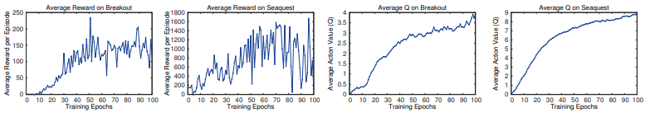
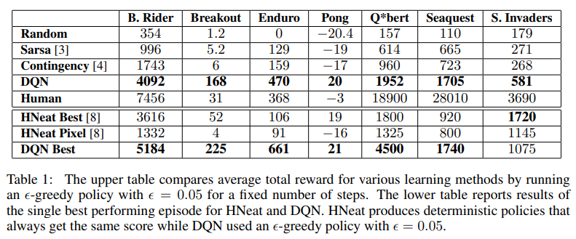
experiments

